Slide 1
Project Summary - Mobile Stander for GMFCS Level IV Pediatric Patients
April 23rd, 2021
Team UNIStand (ADT20) - Robert Huang, Rachel Li, Ashley Koenig, Nyeli Kratz
Notes:
Ashley Hi everyone, we would like to welcome you to the committee meeting for Advanced Design Team 20, better known as Team UNIstand. We really appreciate all of your support throughout the development of this project and our wonderful stander. Today, we’ll just be going over the progress we’ve made in the past year, and we will also have some questions for all of you at the end.
Goals are to make sure all mentors are on the same page and receive their feedback for each design criterion (Ex: not focusing on compliance, but primarily focusing on support and propulsion; asking DO YOU AGREE?) Present the decisions for which you want feedback, present the main risk that you want to eliminate.

Slide 2
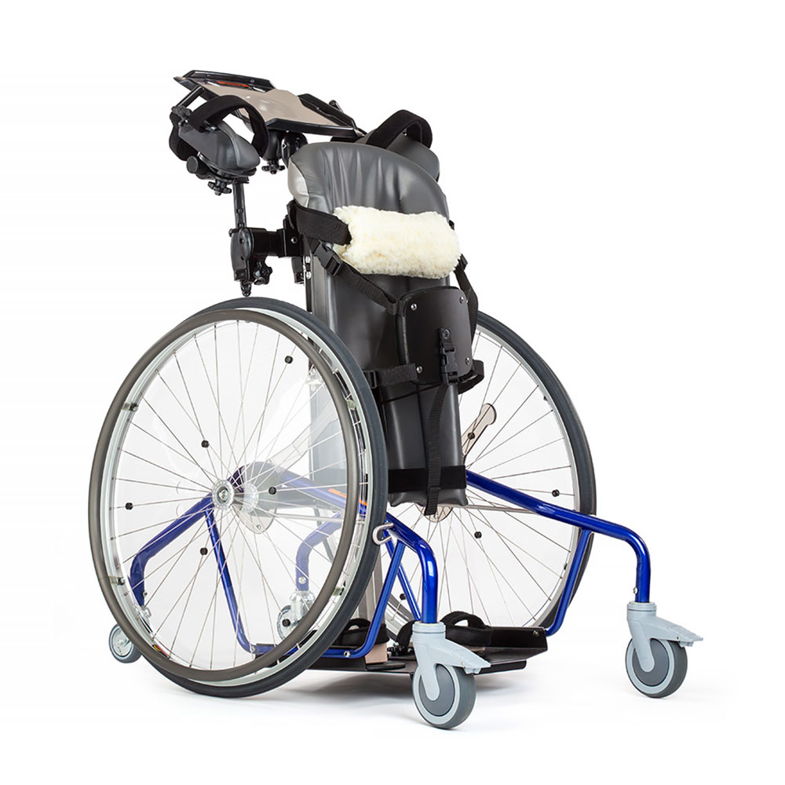
Background and Opportunity
Progress Updates
Design
Risks/Testing
Action Plan
Questions
Background
4000 children with hemiplegia and GMFCS Level IV,
causes include cerebral palsy or traumatic brain injury
Consequences of prolonged sitting:
Respiratory, circulatory, muscular, and gastrointestinal issues
Exposed to social stigma, depression, and anxiety
Loss of independence
Issues with current mobile standers:
Motorized standing wheelchairs: expensive, unreliable,
only passive engagement
Mechanical standers: require the use of two arms
Need Statement:
“Pediatric cerebral palsy patients with a GMFCS level of IV and one impaired arm need an affordable means of independent standing mobility in order to improve their physical and social health and development.”
GMFCS Level IV Mobility Options
Notes:
Rachel
As you may know, our project was inspired by a clinical need experienced by our target patient population.
This population consists of children who have difficulty standing and have one impaired arm, which are commonly caused by cerebral palsy or a traumatic brain injury.
More specifically, these children have hemiplegia and a GMFCS level of 4 (gross motor function classification system)
As shown in the image, children with a GMFCS level of 4 typically rely on mobility devices such as prone standers, wheelchairs, or walkers with caregiver assistance. Outside the home, they usually use wheelchairs or powered mobility devices. However, sitting for prolonged periods of time can result in a variety of health issues including (first bullet point). Additionally, since they are unable to meet peers at eye level and keep up with various activities, they may experience (second). There is often loss of independence / inability to perform independent activities of daily living.
Standing mobility has been shown to alleviate most of these issues, but current mobile standers are not well suited to this population. (read slide) (mention Rifton).
(Need statement)
The goal of our project is to design a device to better serve the needs/increase independence of these children.
(picture)
https://cerebralpalsy.org.au/our-research/about-cerebral-palsy/what-is-cerebral-palsy/severity-of-cerebral-palsy/gross-motor-function-classification-system/

Slide 3
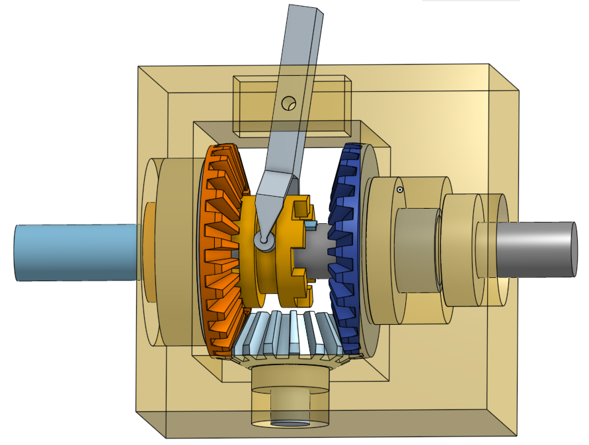
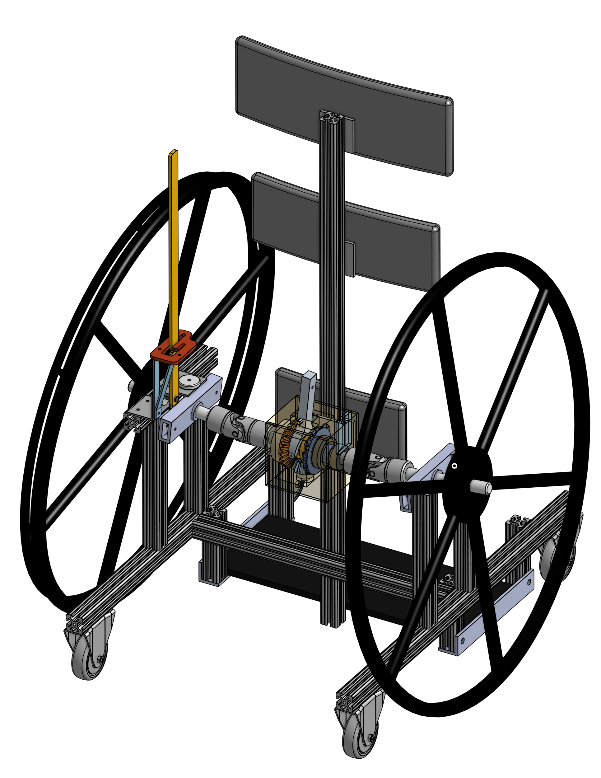
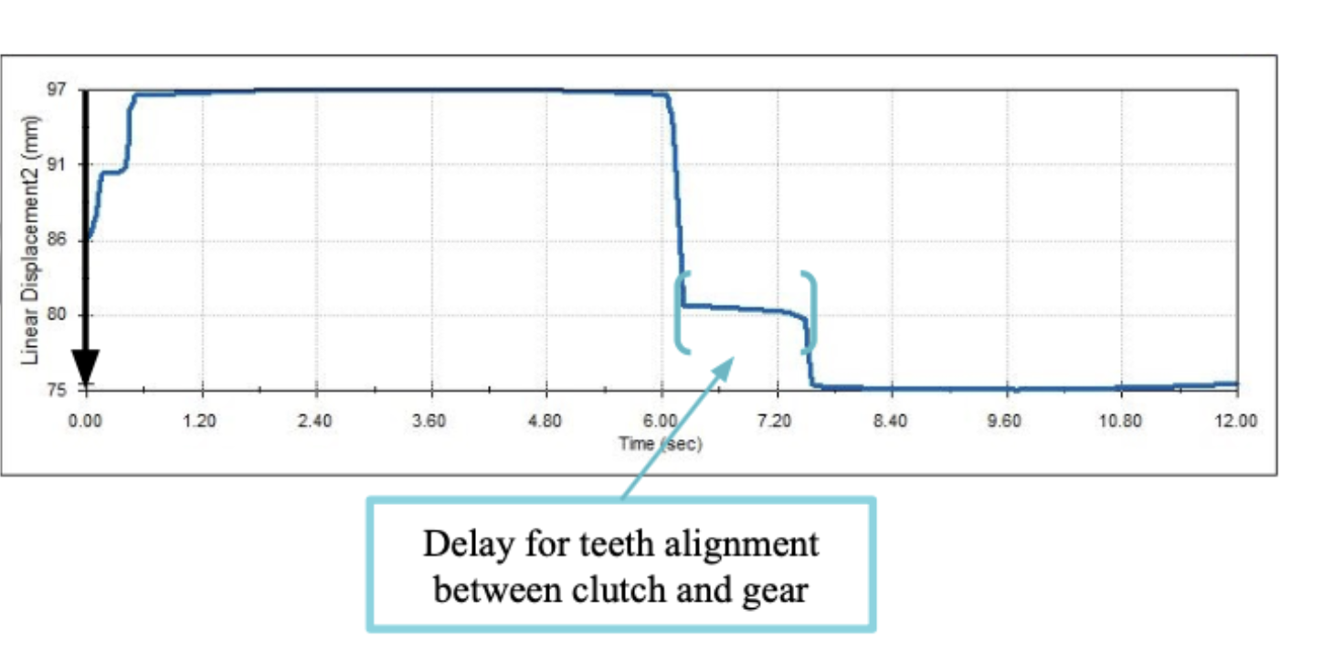
Background and Opportunity
Progress Updates
Design
Risks/Testing
Action Plan
Questions
Previous Design
Problems:
No gradual turning
Gear slop decreases intuitivity and mobility
Notes:
Ashley Our first solution, which was based off initial research of existing products and interviews w/ stakeholders, was a double-rim drive stander, which you can see on the slide here. However, we identified some major problems with the design. One of the most prominent of these issues was the lack of gradual turning. After conducting more customer discovery research, we decided that gradual turning was a necessary component of our design. Additionally, we had some issues with the gear slop, for it affected intuitivity and mobility. As a result, we decided to pivot from this design. But first we thought it would be beneficial to conduct some more research...
https://cerebralpalsy.org.au/our-research/about-cerebral-palsy/what-is-cerebral-palsy/severity-of-cerebral-palsy/gross-motor-function-classification-system/

Slide 4
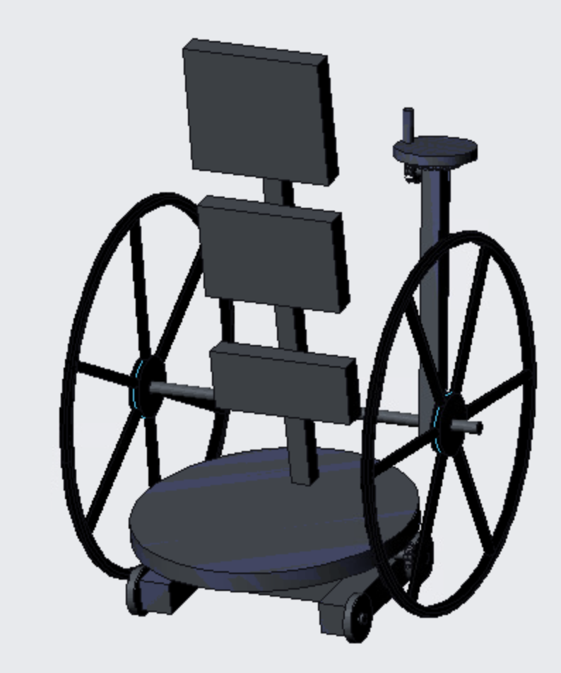
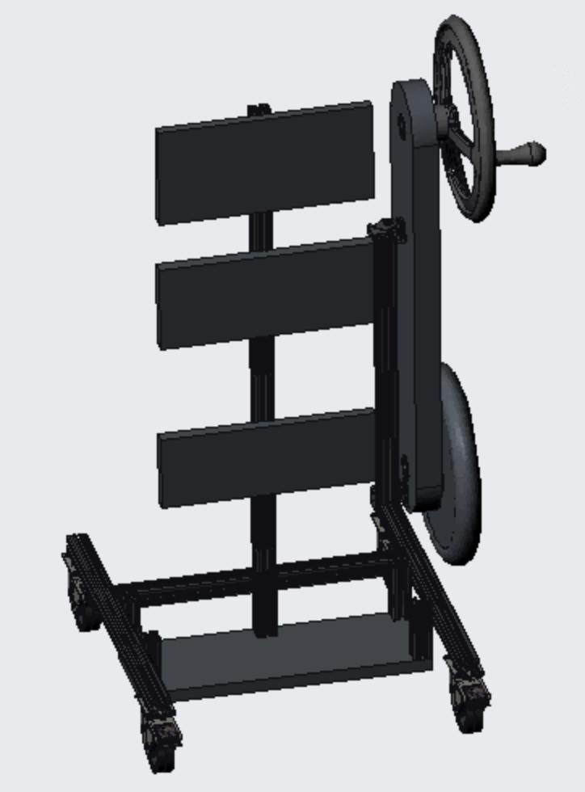
Background and Opportunity
Progress Updates
Design
Risks/Testing
Action Plan
Questions
Customer Discovery
Spoke with 3 patients & families, 3 physical therapists
Typical usage patterns
Desired device specifications
Feedback on preliminary designs
Key conclusions:
Need swiveling + gradual turning
Must be small, lightweight
Must be stable
Lever is intuitive
Electricity is not a problem
Notes:
Rachel
Last summer, we performed customer discovery to help guide us through the redesign process. We had two main goals: to better cater to patients’ needs and to evaluate design options that would solve our mechanical issues. As part of this process, we spoke with 3 patients and their parents as well as 3 physical therapists. In these interviews, we asked about patients’ typical device usage patterns (i.e. what they used the stander for, where they used it, how often they used it), what they were looking for in a stander, and also asked for feedback on our 3 preliminary designs (shown here are the 2 designs we did not choose to move forward with). Our main findings were that (read slide). We sought to fulfill all of these specifications with our final design.

Slide 5
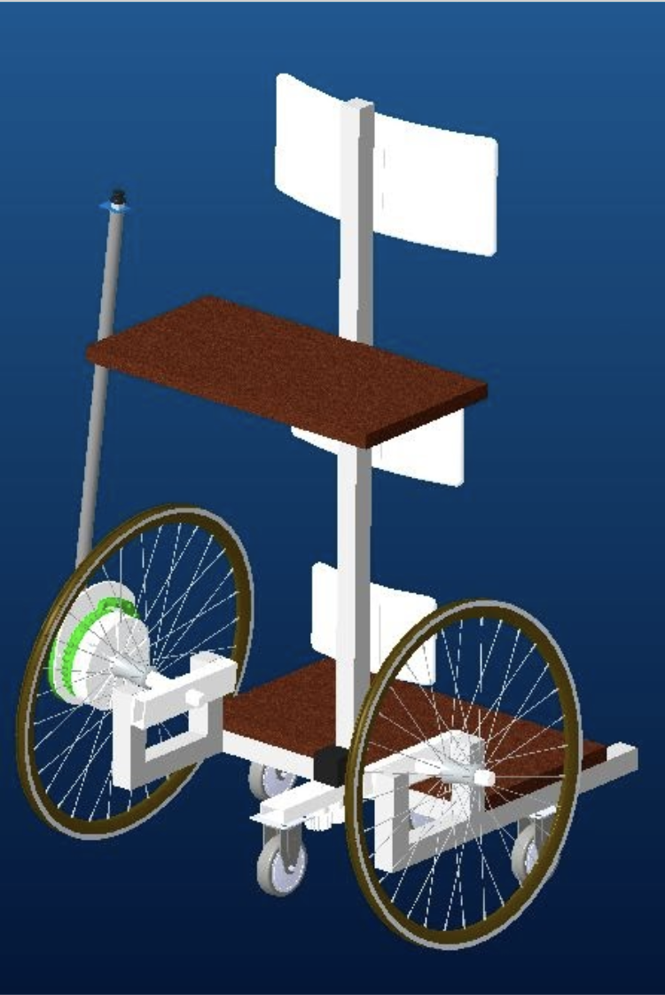
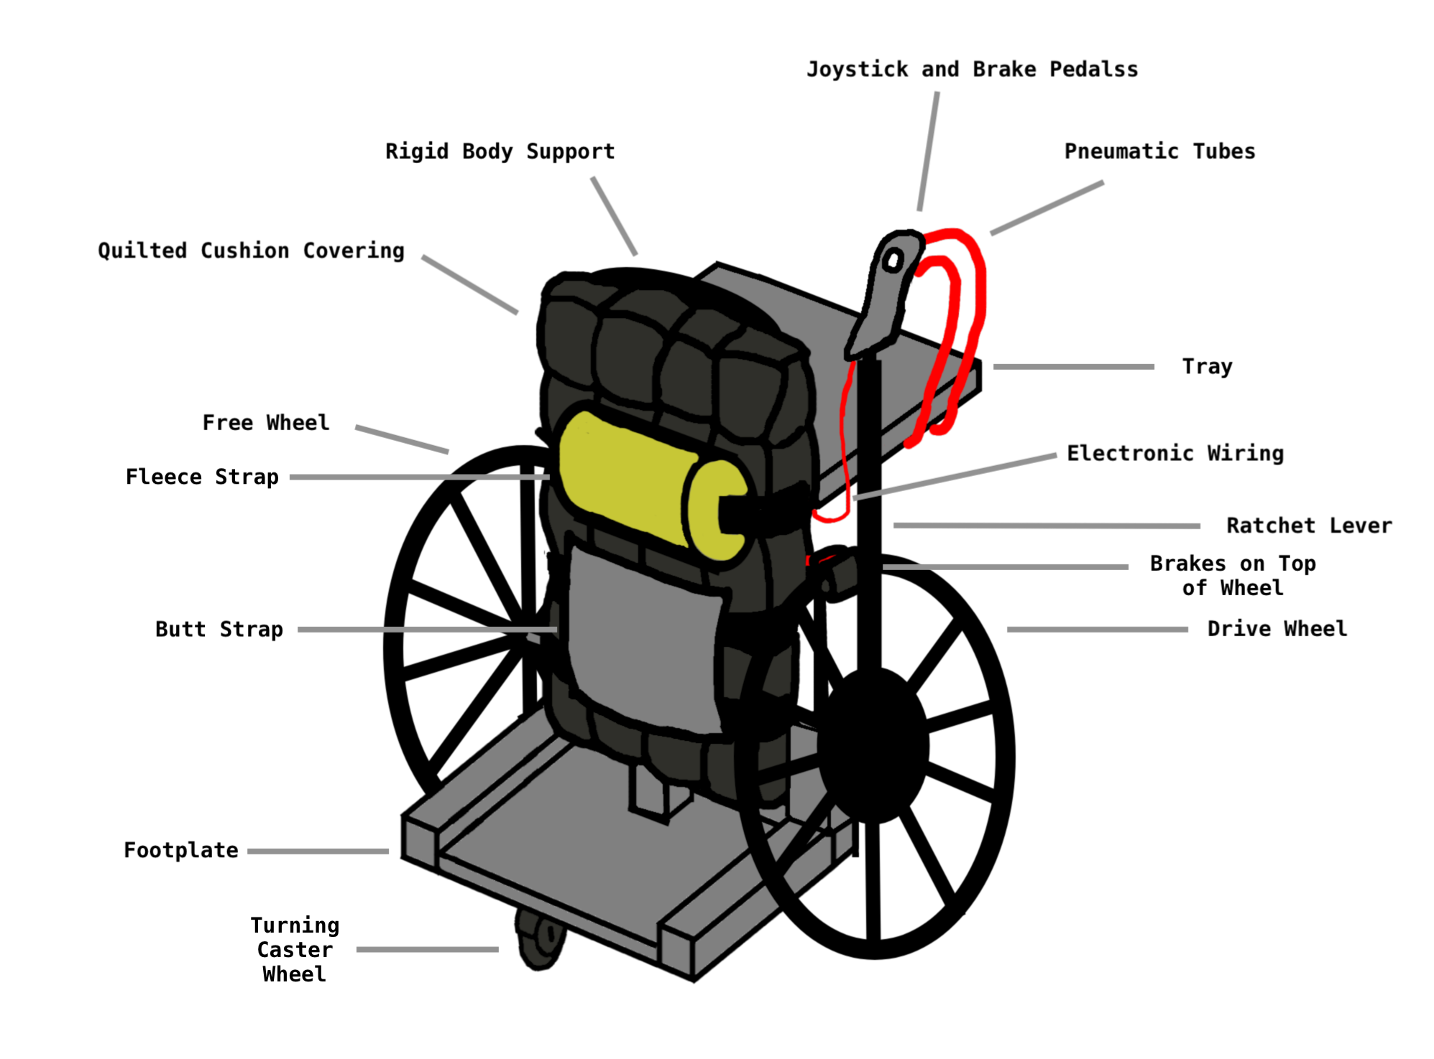
Background and Opportunity
Need and Criteria
Progress Updates
Design
Risks/Testing
Action Plan
Questions
Overall Final Design
Propulsion and steering
Frame and supports
Notes:
Robert
Here is our final design. The frame of the new design has not altered too significantly from existing competitors or the previous design. Most notably, this new design features a different steering and propulsion mechanism. Because it was deemed intuitive from the customer discovery, users will now propel by rowing a lever. And, since electricity greatly improved the range of motion with one hand, and since the feedback indicated that electricity was not an issue, this new design incorporates minimal use of electricity in order to steer the stander. As such, users will also now steer using the joystick on top of the lever, the design of which we will discuss further.

Slide 6
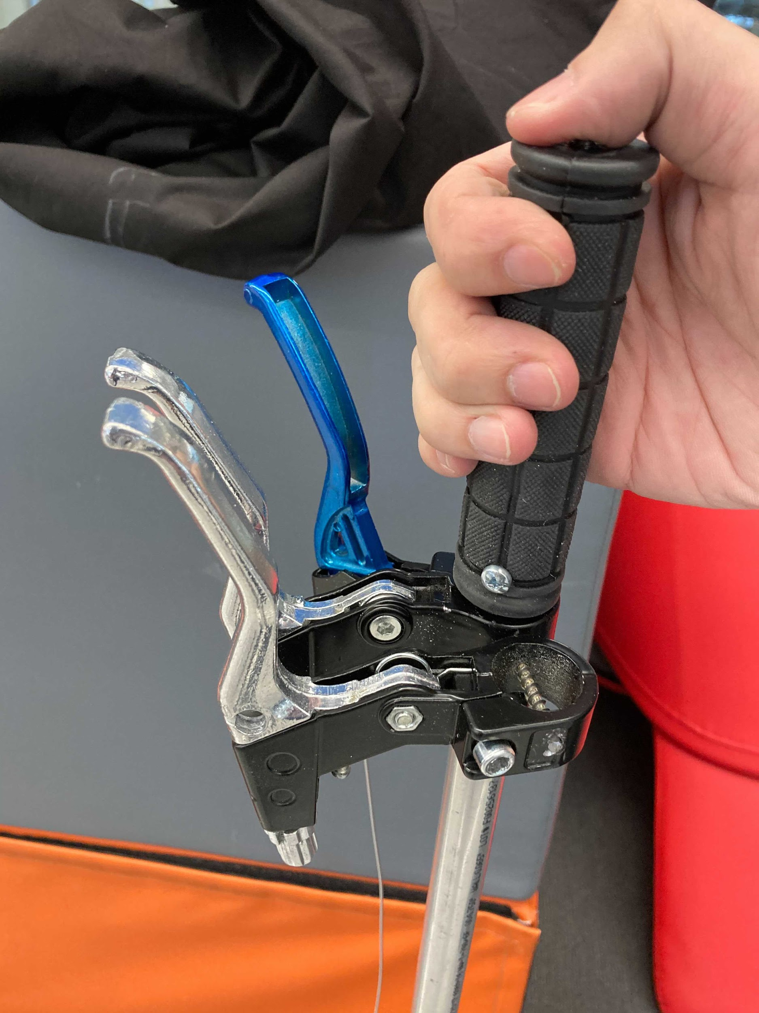
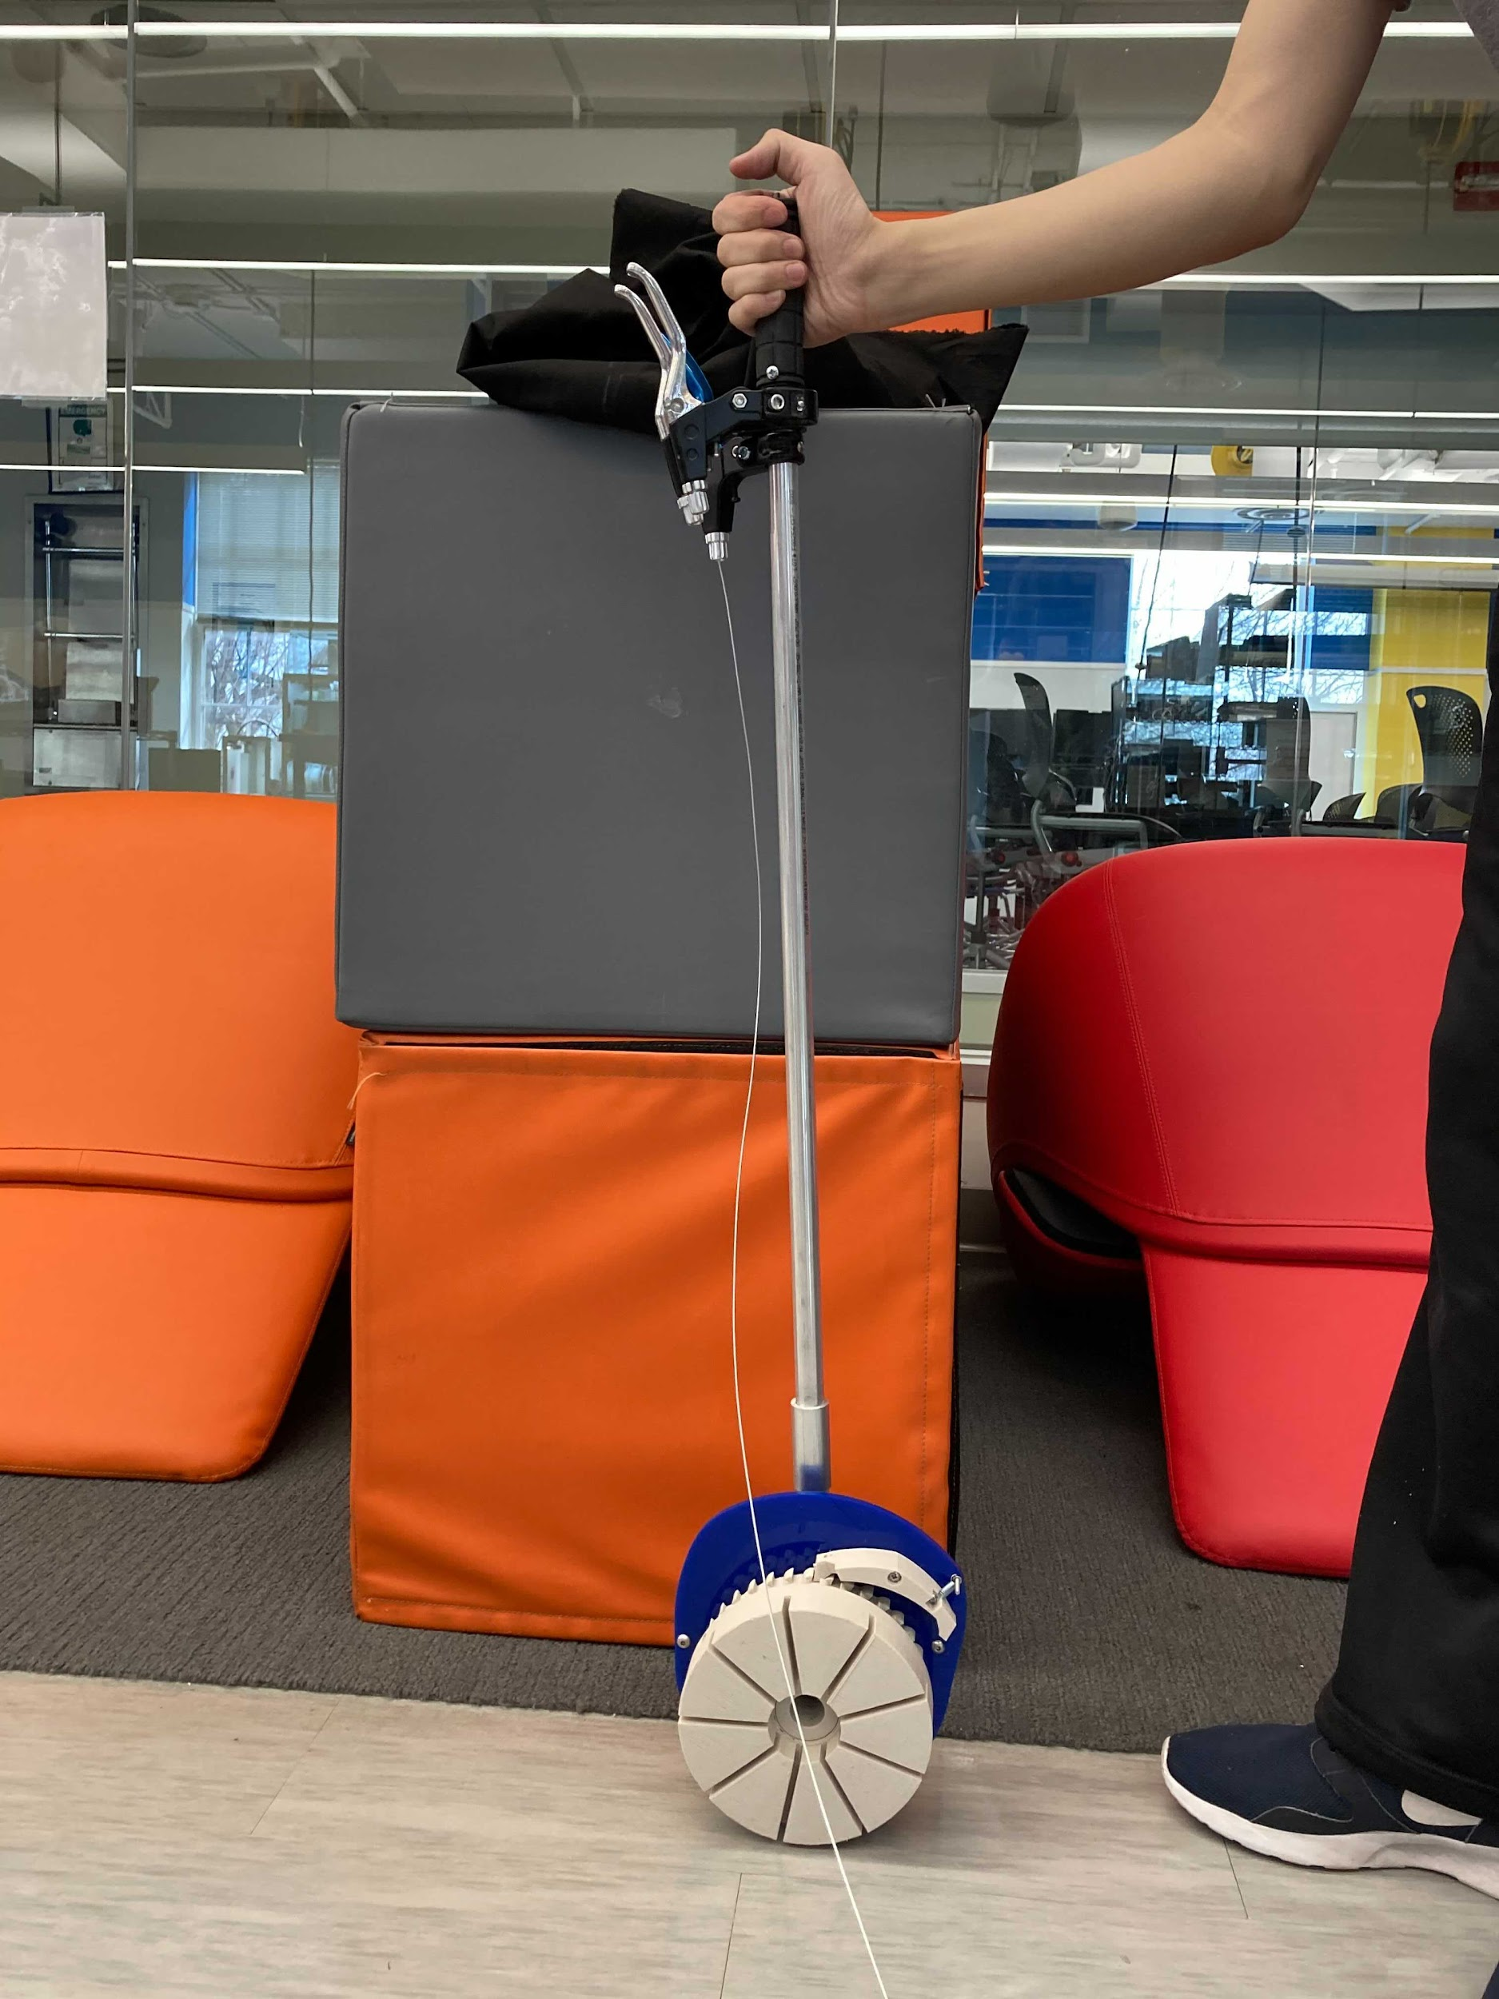
Background and Opportunity
Need and Criteria
Progress Updates
Design
Risks/Testing
Action Plan
Questions
Propulsion Mechanism
Steer
Reverse
{
Brake
Notes:
Nyeli
We decided to go with a lever-drive system to give us more freedom when choosing wheel size for the stander to allow for lighter weight and smaller footprint to improve usability in the house. We designed and built this lever based off of the Kate Reid Hand Drive Lever, and open-source project which helps wheelchair users create a low-cost lever to propel their wheelchair which can help alleviate the back pain caused by bending over to propel a wheelchair. To modify this design. We extended the length of the lever to allow it to be used in the standing position. We also added brakes to allow the user to brake the stander from the lever and we added a joystick to the top of the grippy handle to implement the steering correction necessary for manual propulsion of a one-arm-drive device.

Slide 7
Background and Opportunity
Need and Criteria
Progress Updates
Design
Risks/Testing
Action Plan
Questions
Overall Design
Propulsion and steering
Frame and supports
Notes:
Nyeli
Now I’ll talk about our novel steering mechanism which allows the user to turn, swivel, and drive straight using only one arm to propel.

Slide 8
Background and Opportunity
Need and Criteria
Progress Updates
Design
Risks/Testing
Action Plan
Questions
Steering Mechanism
Overall motion:
Overall motion:
Overall motion:
Notes:
Nyeli
We redesigned our steering mechanism to eliminate the gear slop issue and allow the user to turn gradually as well as swivel. Having the wheels arranged a diamond shape, as shown, allows for easy switching between swiveling, turning, and driving straight. On the left, the caster position allows the user to drive straign while only pushing one wheel. The middle picture allows the user to turn gradually, and the rightmost picture allows the user to turn about their central axis.

Slide 9
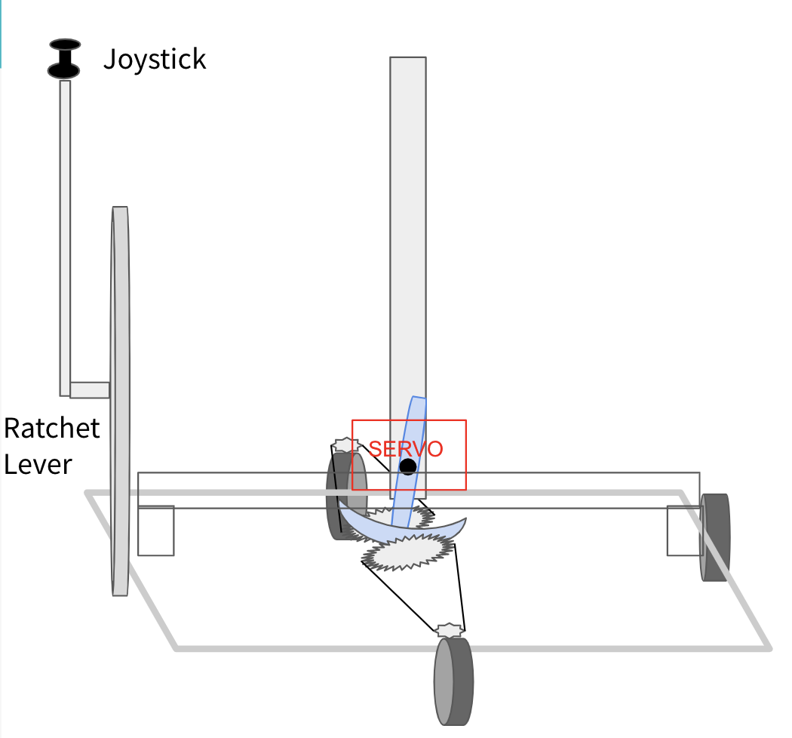
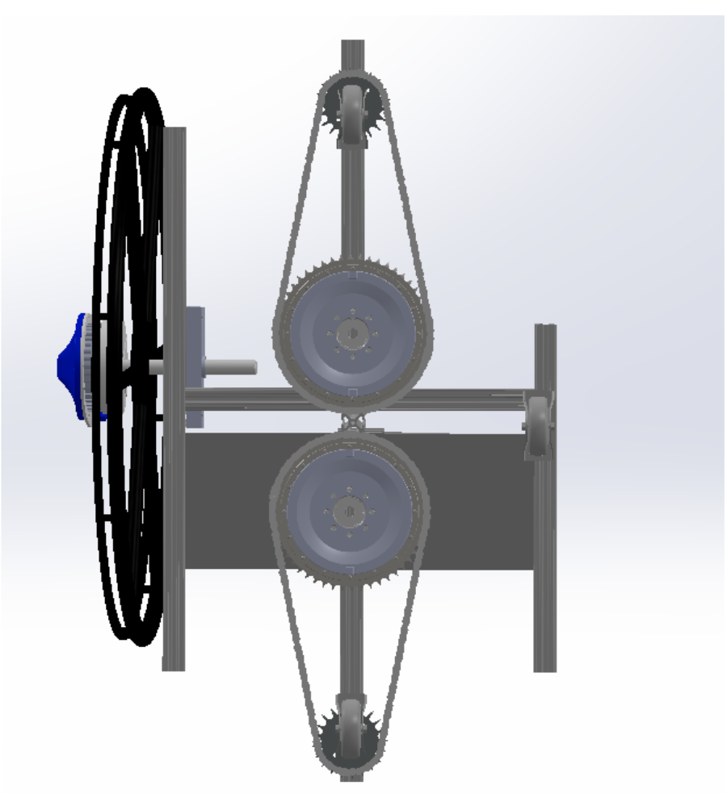
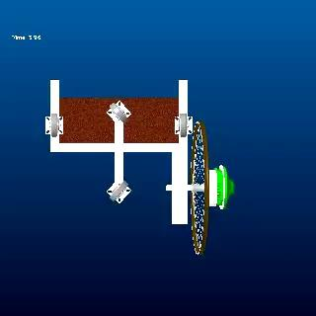
Background and Opportunity
Need and Criteria
Progress Updates
Design
Risks/Testing
Action Plan
Questions
Steering Mechanism
Schematic View
POV from Below
Theoretical Movement
Notes:
Nyeli
Here is how we decided on accomplishing this motion. We designed a mechanism which uses a servo motor to drive sprockets which steer the casters. To the left, you can see an isometric schematic view, in the middle is a CAD model with an idea of what the steering mechanism would look like from below with the gears, sprocket, and chains. In the video you can see the theoretical movement of the two caster wheels as a servo motor on one drive gear is turned.

Slide 10
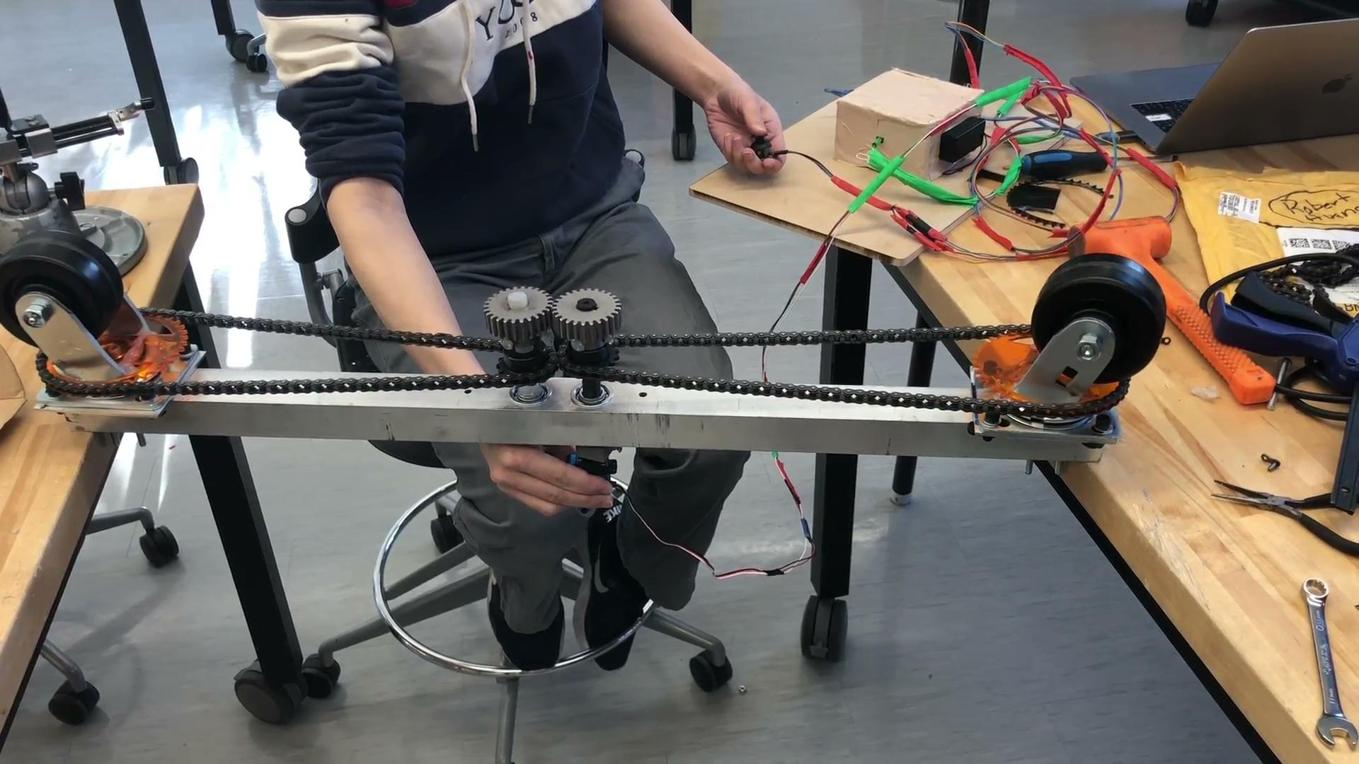
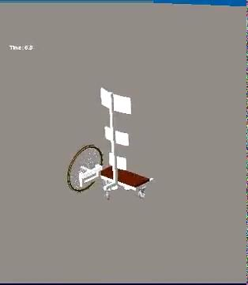
Background and Opportunity
Need and Criteria
Progress Updates
Design
Risks/Testing
Action Plan
Questions
Steering Mechanism
Notes:
Nyeli
Here you can see our physical prototype where we use a servo motor to drive two central caster wheels. The user can push the joystick left or right, as you can see to the video on the left, and it will rotate the casters left or right, allowing the user to turn as sharply as they wish and without stopping the device. On the video to the right, you can see our Creo simulation which helped us to verify the idea that two turned central casters would allow the stander to with near-perfect swiveling. Here you see how turning the casters all the way to one direction or the other allows the user to turn in almost a perfect swivel theoretically.

Slide 11
Background and Opportunity
Need and Criteria
Progress Updates
Design
Risks/Testing
Action Plan
Questions
Frame and Supports
Propulsion and steering
Frame and supports
Notes:
Ashley Now we’ll go into details about the frame and supports of our stander. These parts are highlighted in yellow on the slide.

Slide 12
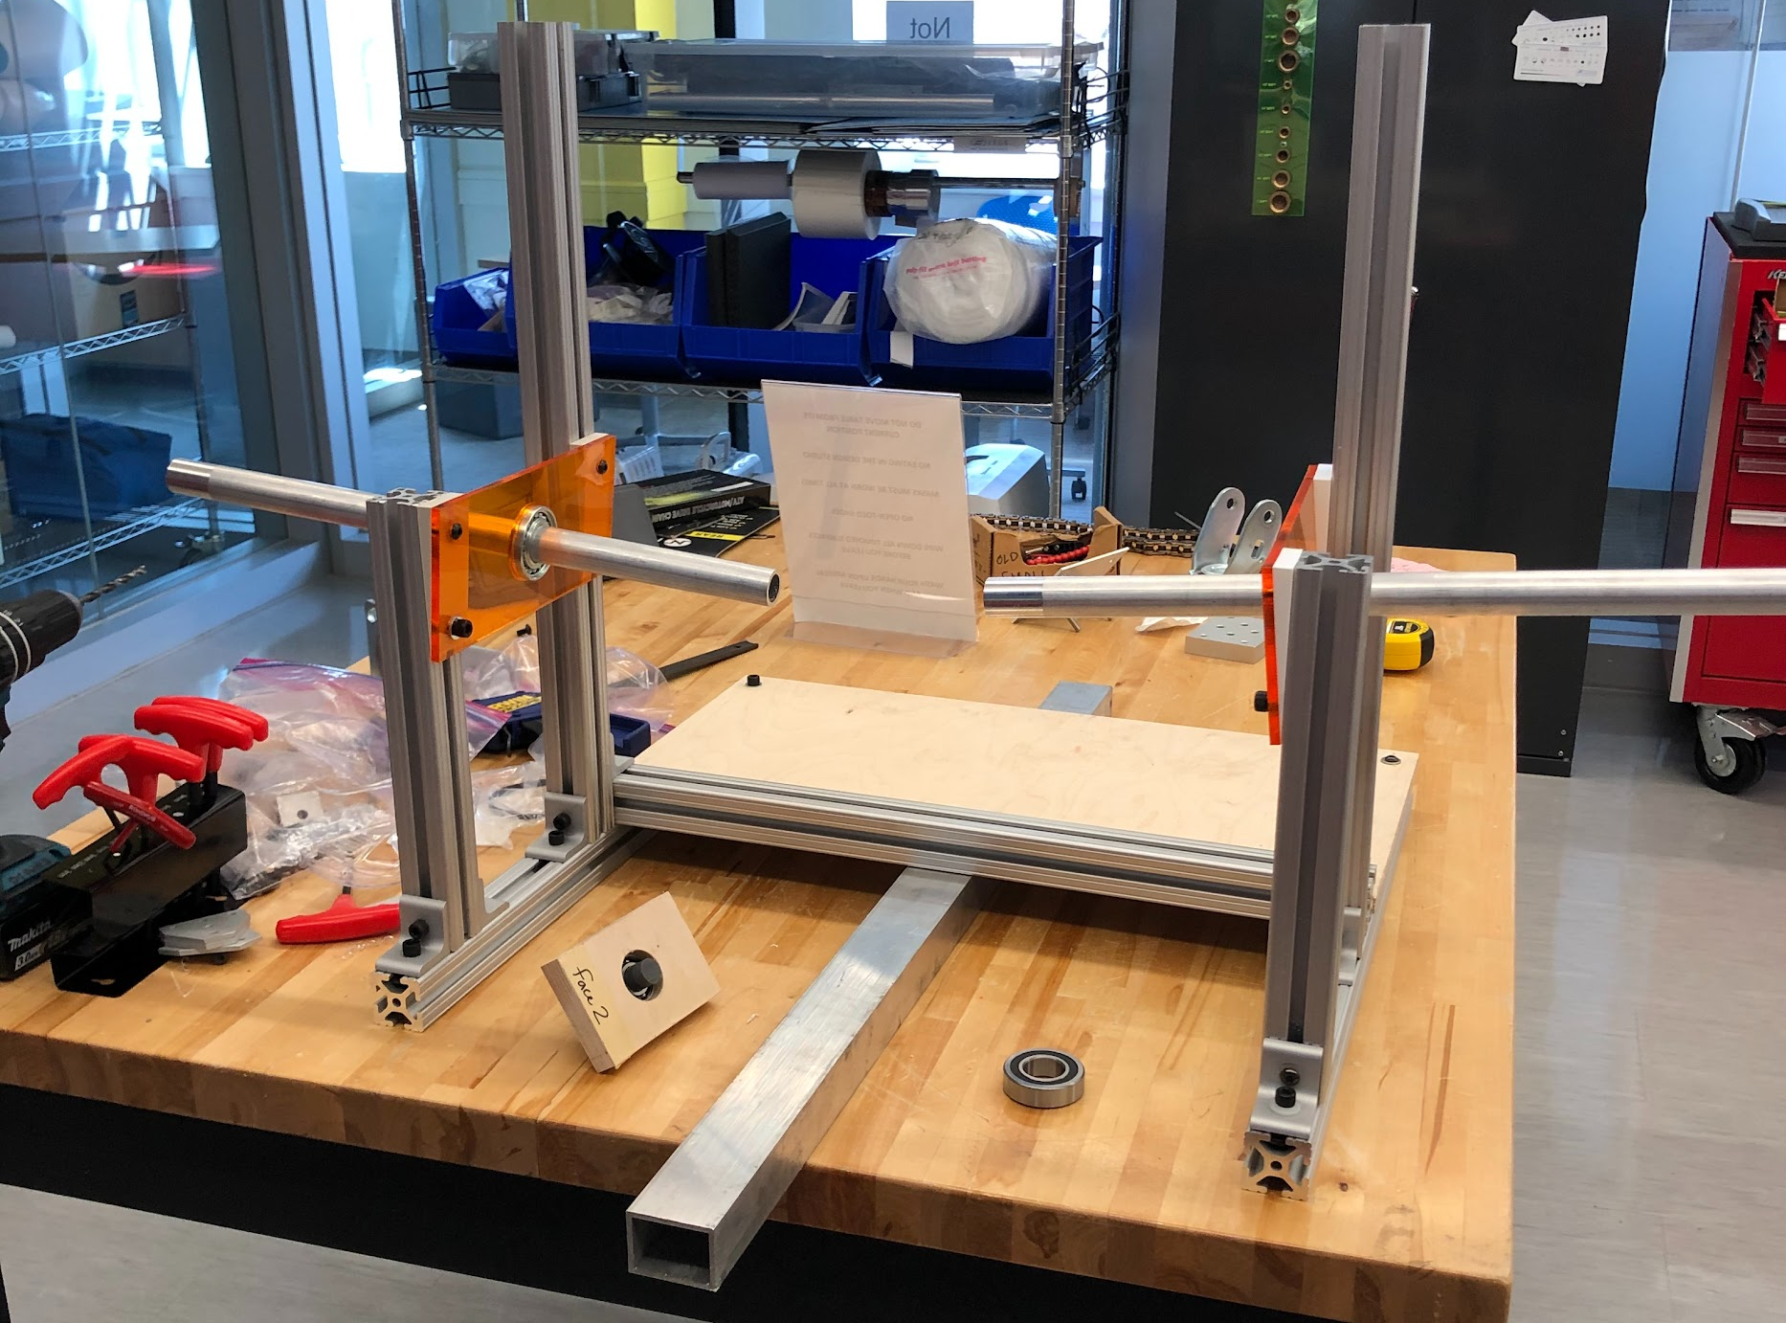
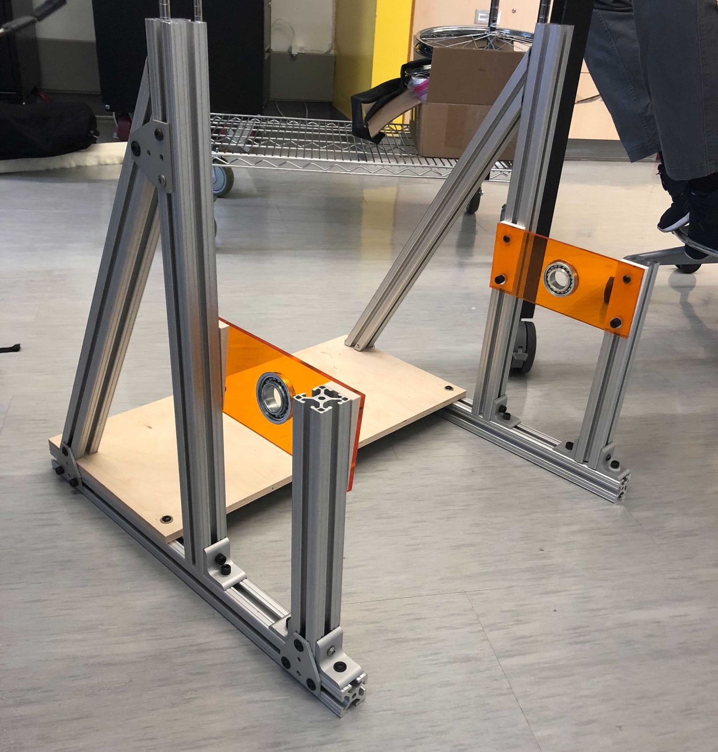
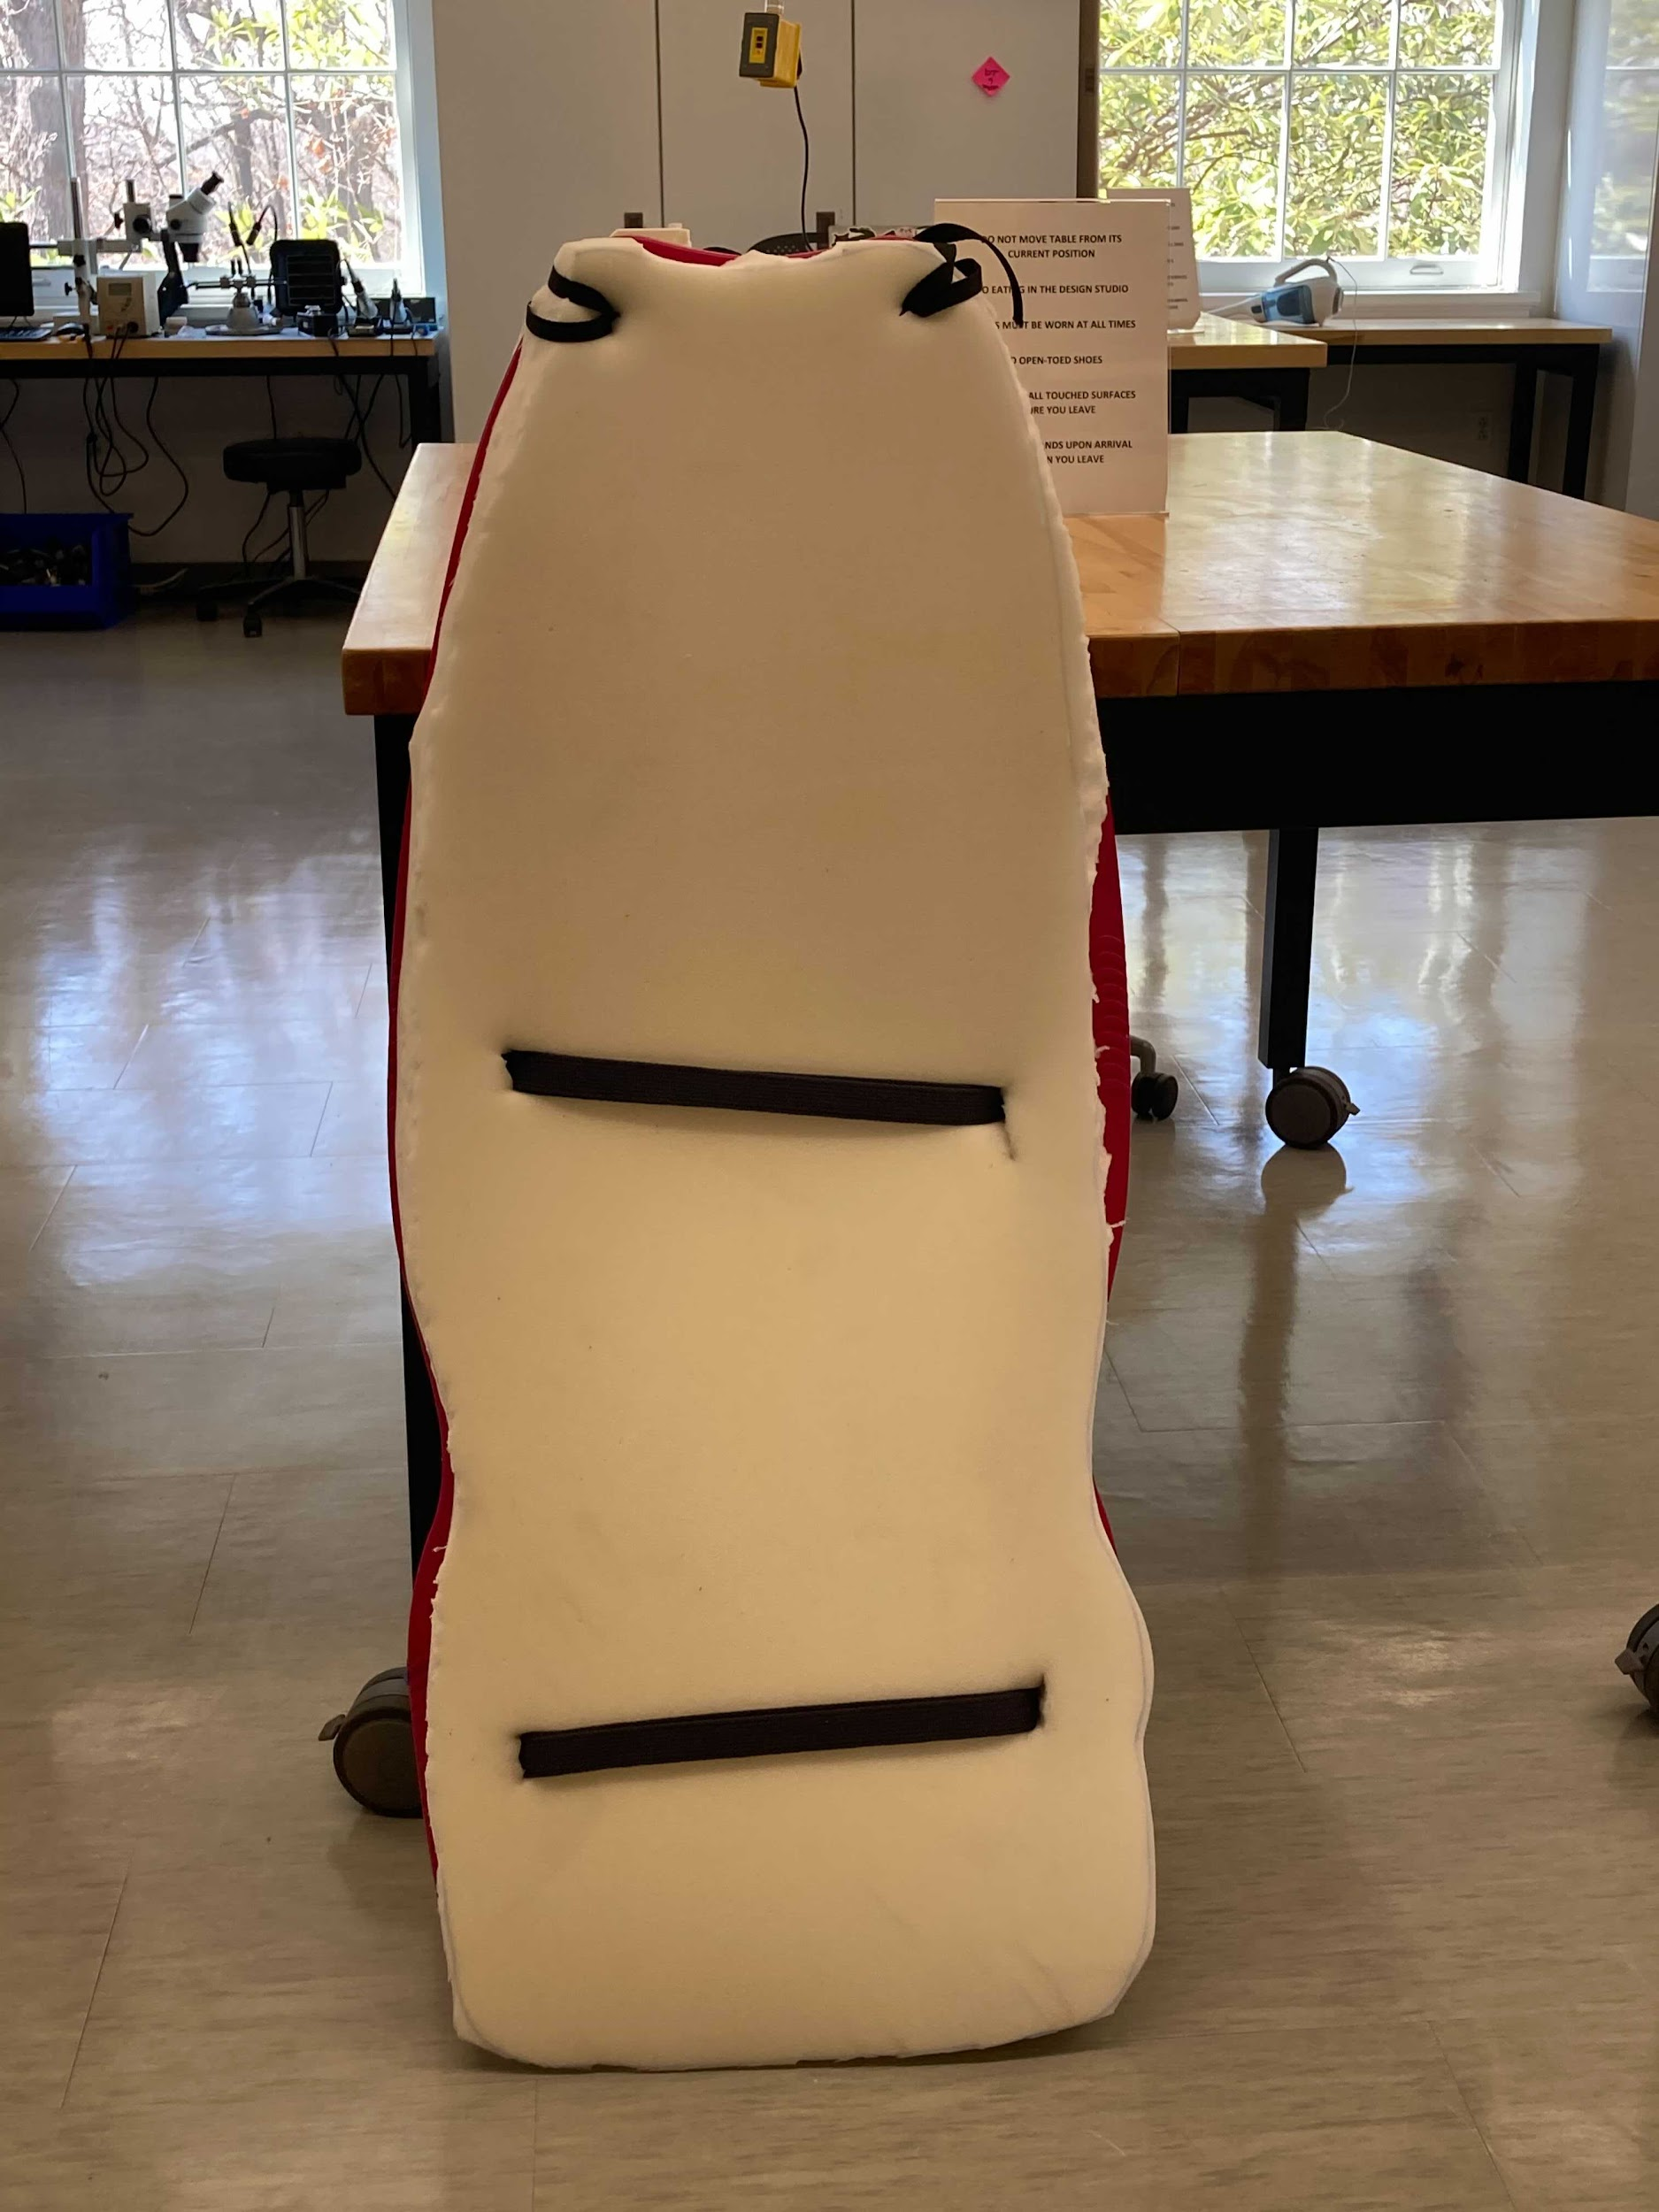
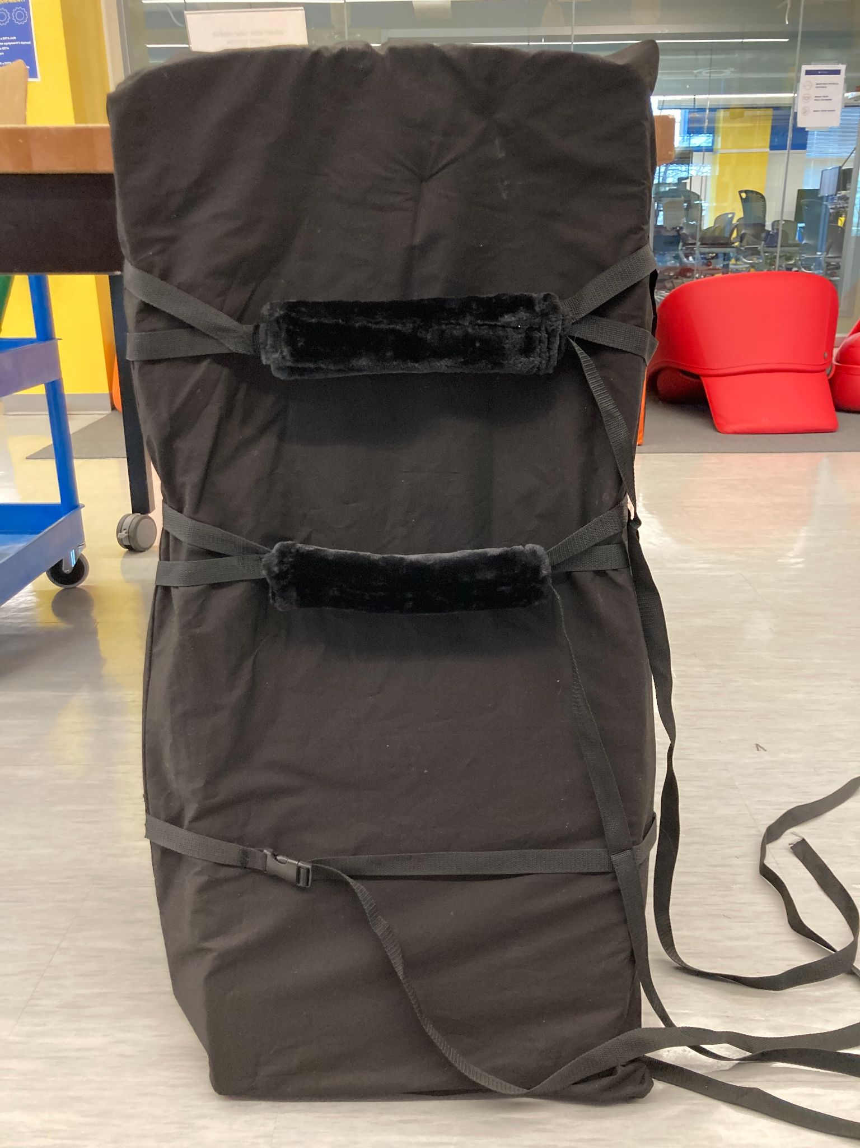
Background and Opportunity
Need and Criteria
Progress Updates
Design
Risks/Testing
Action Plan
Questions
Frame & Supports
80/20 frame
Footplate
Tray
Handrails
Supports
Notes:
Ashley The frame is made of 80/20 parts, as you can see in the top two photos. This frame is sturdy, reliable, and allows for easy adjustments. The footplate is made out of wood, which can also be seen in the top two photos. We also decided to include a wooden tray that users could place objects on. For increased ease of transfer and stability, we added handrails, which can be seen in the top right photo. For the supports, we used a sled as the base, attached a mattress topper for comfort, covered in fabric, and attached straps. The top two straps have comfortable fuzzy covers, and the bottom strap has a seat support.

Slide 13
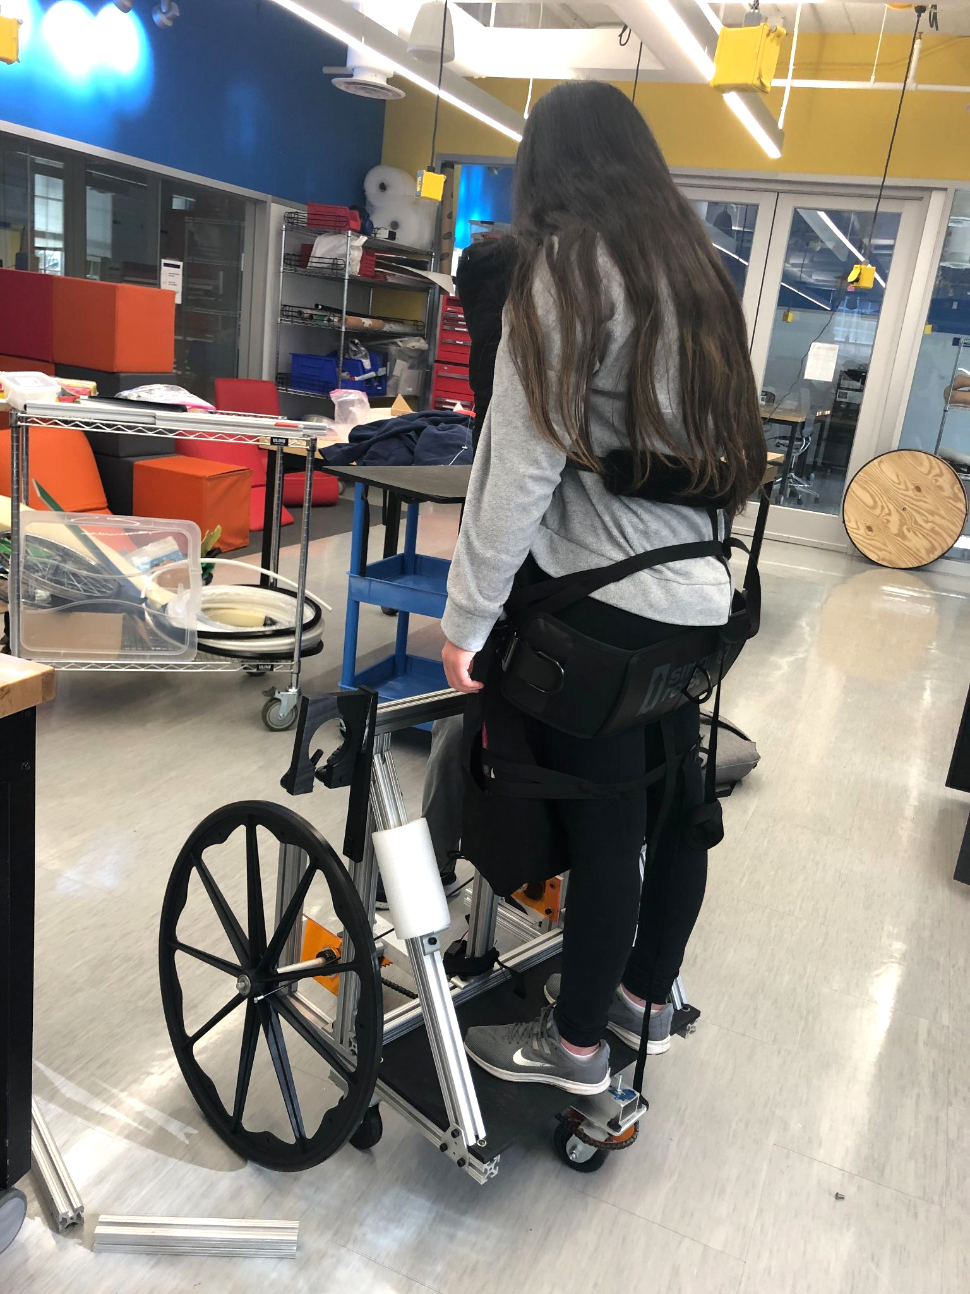
Supports
Notes:
Ashley Here is a picture of all of those supports on our full prototype. It can be a little tough to see, but the seat strap and two fuzzy straps are supporting Rachel as she uses the stander. Additionally, we cut pieces of white foam to add to the handrails for better grip. We have more photos of the full prototype coming up so you can see the device better.

Slide 14
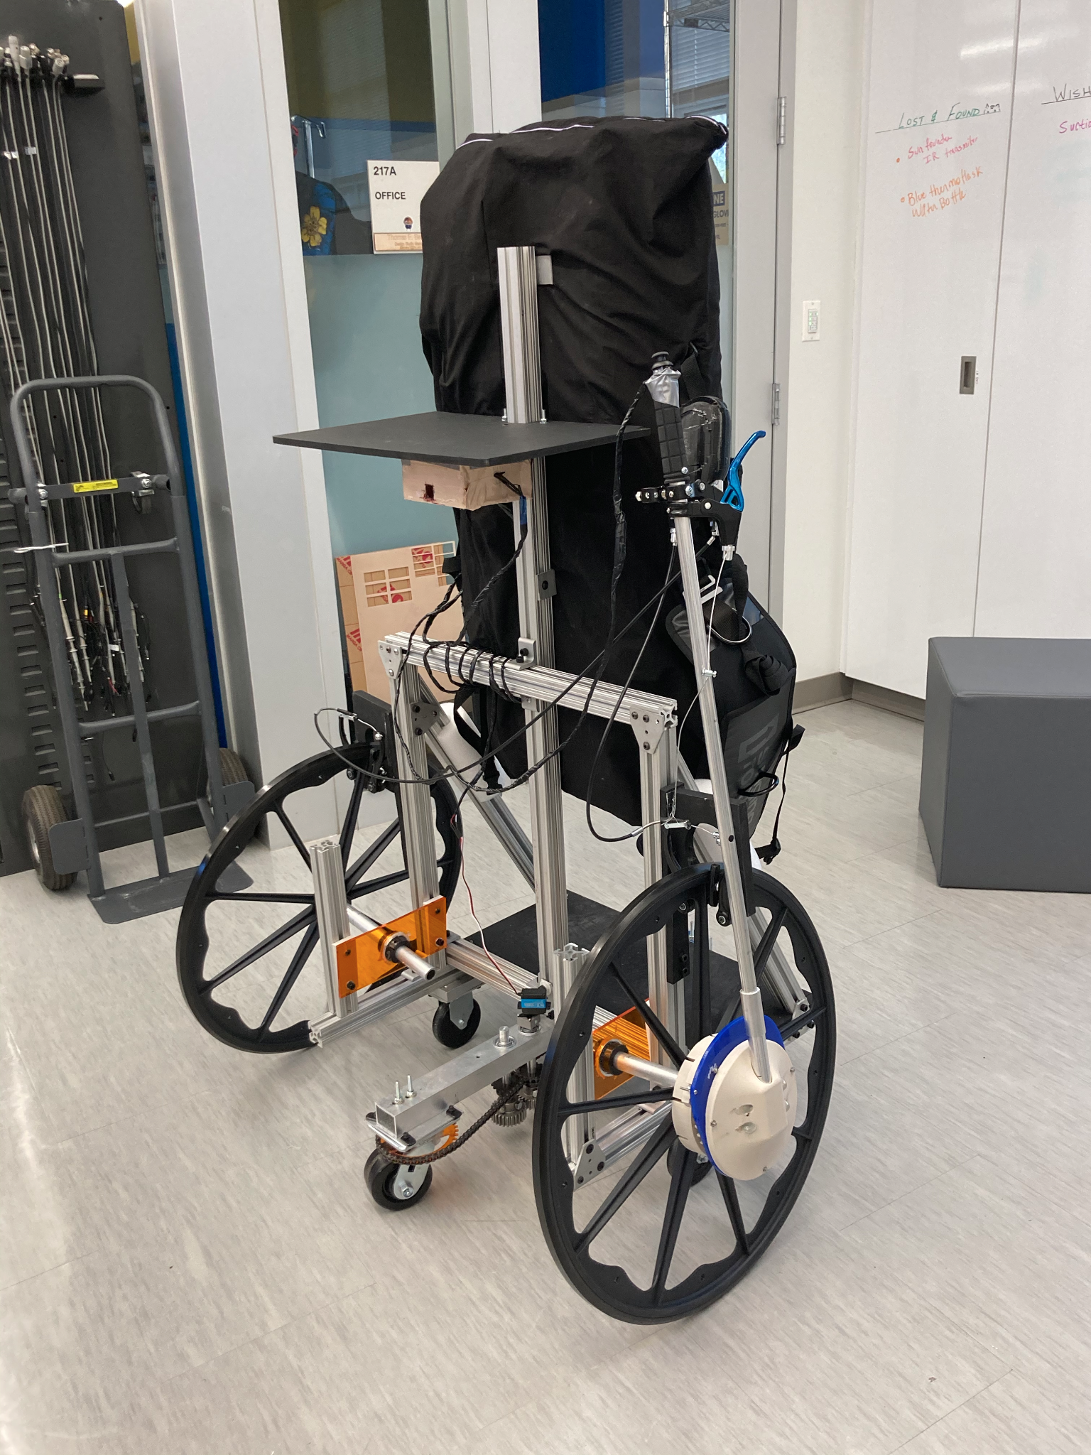
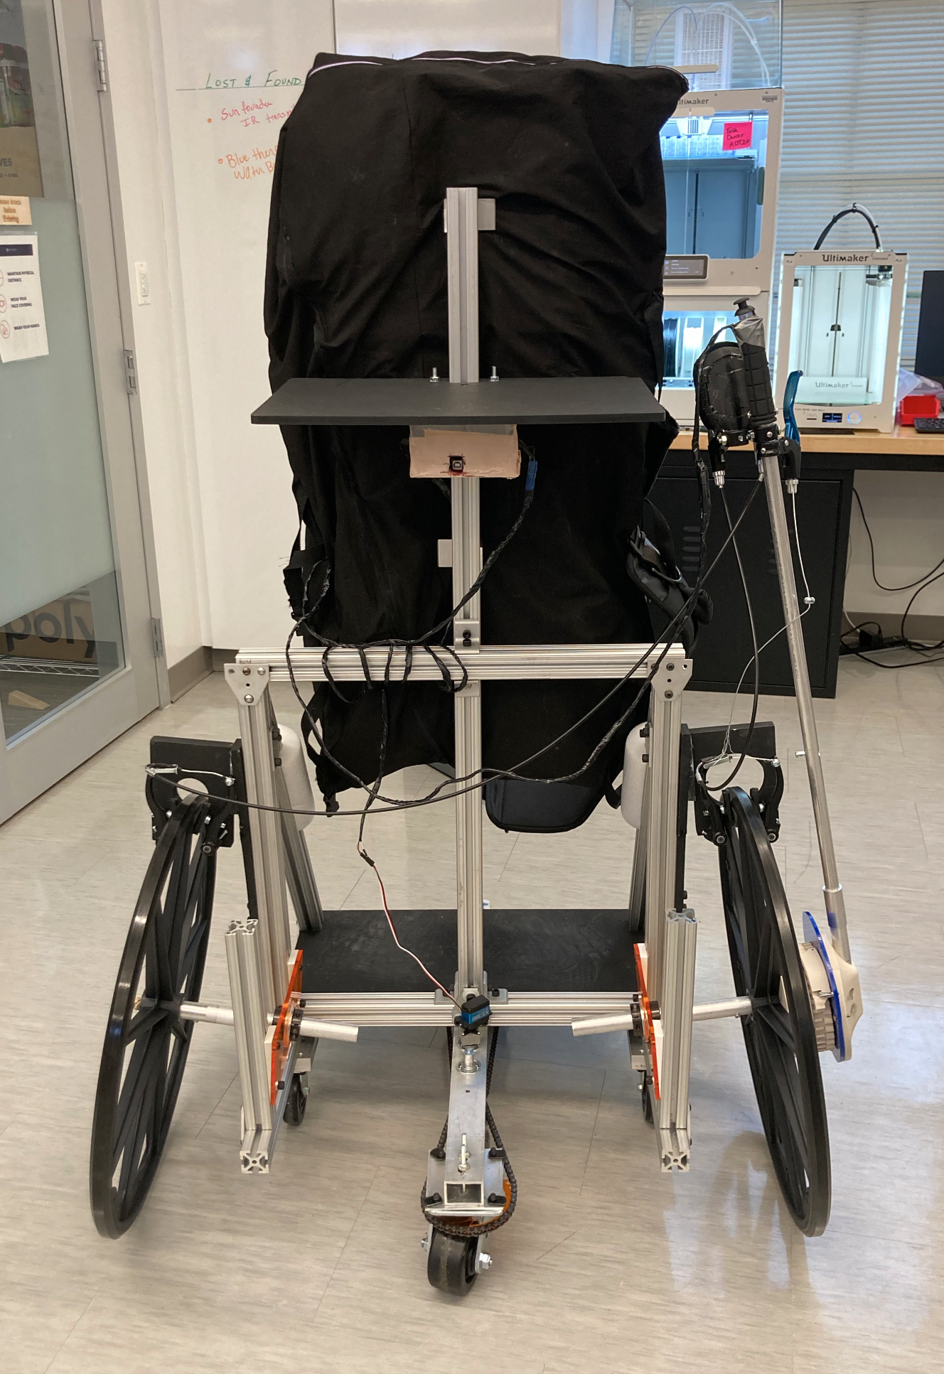
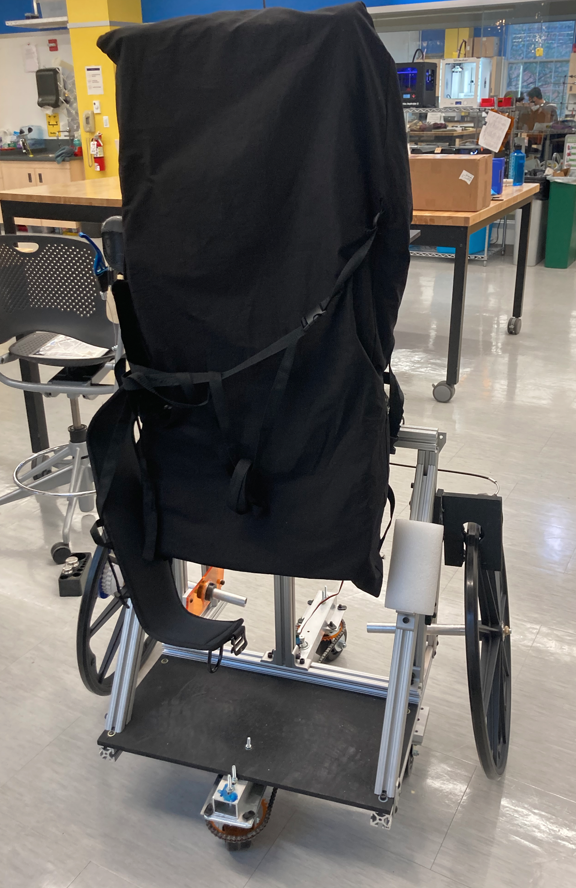
Background and Opportunity
Need and Criteria
Progress Updates
Design
Risks/Testing
Action Plan
Questions
Full Prototype
Notes:
Nyeli
Here is how our full prototype turned out!

Slide 15
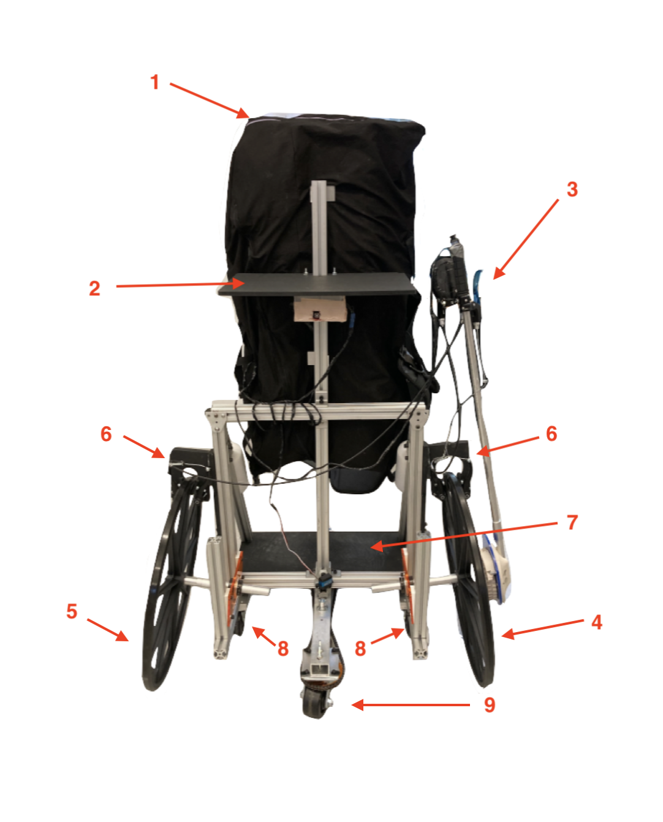
Background and Opportunity
Need and Criteria
Progress Updates
Design
Risks/Testing
Action Plan
Questions
Full Prototype
Supports
Tray
Lever
Drive Wheel
Free Wheel
Brake Attachments
Footplate
Static Casters
Steering Mechanism
Notes:
Nyeli
Here is a picture of our full prototype next to the schematic so you can see how each of the components were implemented physically.

Slide 16
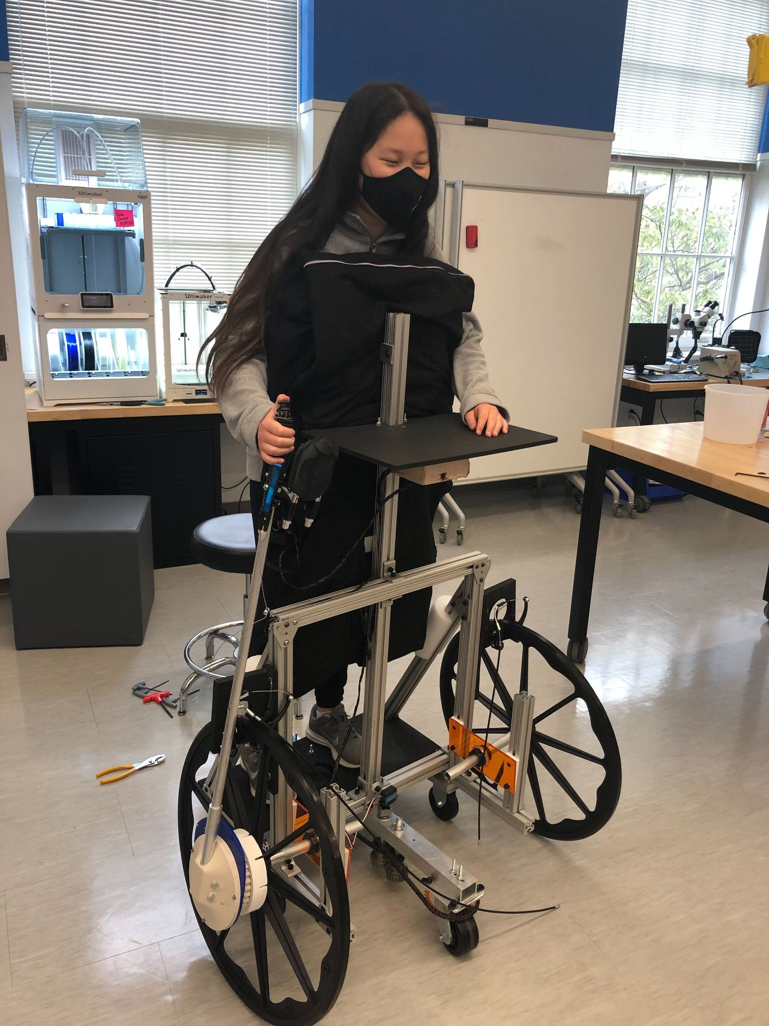
Background and Opportunity
Need and Criteria
Progress Updates
Design
Risks/Testing
Action Plan
Questions
Full Prototype
Notes:
Nyeli
Here is our full prototype and a video of us using the stander! As you can see, our prototype allows us to drive forwards, drive backwards, reverse, and turn using manual propulsion and only one arm.

Slide 17
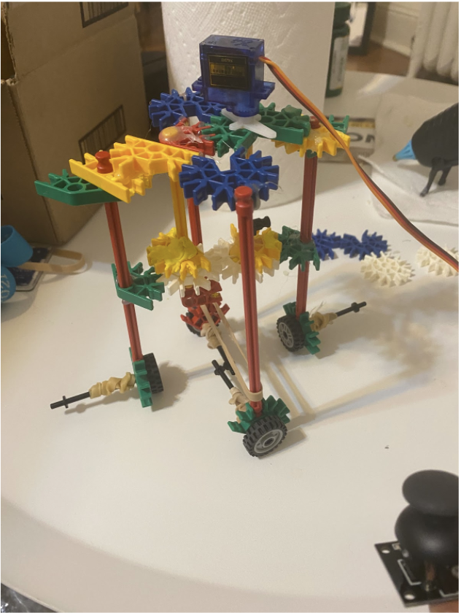
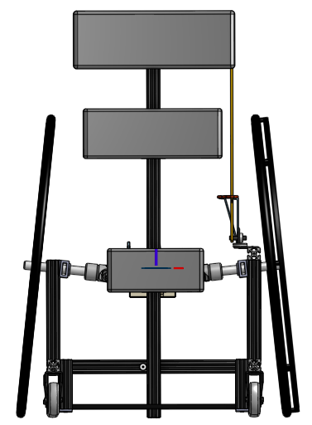
Background and Opportunity
Need and Criteria
Progress Updates
Design
Risks/Testing
Action Plan
Questions
Testing - Components
Propulsion Model
Lego Model indicated <0.58Nm motor required for steering w/ 200lbs load.
Brakes
Force to brake: <10N (<25N)
Frame:
Stability: Better stability than the Rifton
General load: Can carry 200lbs
Lego Model of Steering Mechanism
Notes:
Robert
In order to assess the steering system, the braking system, and the frame, we conducted three main component verification tests. The propulsion model test was performed by creating a lego model of the steering mechanism, equipped with a small torque motor. The goal of this test was to assess if the steering mechanism behaved as we predicted, and to determine what sort of motor we would need for the final large scale prototype. Ultimately, we determined that the steering mechanism behaved appropriately, and that we would require a motor with at most 0.58Nm of torque.
The brakes test was performed to determine if our target population would be able to stop the stander in motion. The force required to hold up 5kg was determined to be 10N, which is far less than the reported grip strengths of average children, around 25N.
Finally, the frame was tested for stability by simulating tilting forces. The stander was pushed perpendicular to the direction of the wheels, and the force required to tilt the stander, and the angle at which it began to fall over was recorded. Due to its weight, the frame’s stability was ultimately determined better than the Rifton. A maximum load was also determined, but, as we did not wish to break the stander, we stopped at 200lbs.

Slide 18
Background and Opportunity
Need and Criteria
Progress Updates
Design
Risks/Testing
Action Plan
Questions
Testing - Full Model Verification
Force to Propel
Requires <10N to propel (<25N)
Turning Radius
Radius: 40” (Above desired limit)
Braking Distance
>0.01m, due to weight
Notes:
Robert
Besides the components, after the prototype was complete, we sought to test various values necessary for its function. The force to propel the stander was determined to be less than 10N, which is less than the reported 25N that the average child’s arm can output.
The turning radius, which was determined by swiveling our completed prototype, was determined to be 40”, which is above the 36” desired limit for our stander. To resolve this result, we hope to decrease the size of the stander. We will reassess the stability after we do so.
Finally, due to the weight of the stander, the braking distance was determined to be less than 10cm.

Slide 19
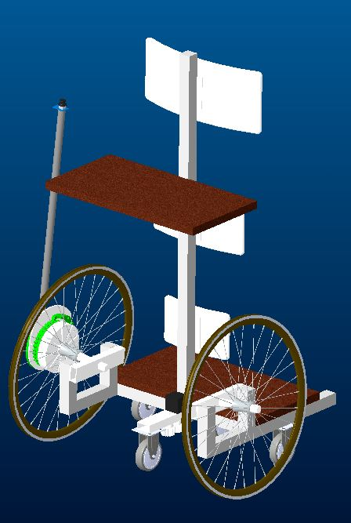
Background and Opportunity
Background and Opportunity
Need and Criteria
Need and Criteria
Progress Updates
Design
Risks/Testing
Action Plan
Questions
Questions
Project Timeline
Simulations
Prototyping
?
Customer discovery
Component testing
Initial Solution
Redesign
Current stage
Future plans
Notes:
ALL
Regarding the DHF, for Advanced DT, should we add onto the previous year’s Prototype History/ Design Journal

Slide 20
Thank You
to our clinical mentors: Dr. Suskauer, Mr. Joseph, and Dr. Paul,
our Design Team faculty: Dr. Miranda and Mr. Benassi,
and our wonderful TA: Jordan Shuff
for your continued help and support with our project!

